Slide 1
Chapter 1: Introduction

Slide 2
Chapter 1: Introduction
What Operating Systems Do
Computer-System Organization
Computer-System Architecture
Process Management
Memory Management
Storage Management
Protection and Security
Kernel Data Structures
Notes:
Most important – multithreading programing
Hardware and key components - how they work together (covered 244)
Process, Memory, and Storage Management

Slide 3
What is an Operating System?
A program that acts as an intermediary between a user of a computer and the computer hardware
Operating system goals:
Execute user programs and make solving user problems easier
Make the computer system convenient to use
Use the computer hardware in an efficient manner
Notes:
Operating system = software or program
- acts as resource or hardware manager
- intermediary between user and hardware
- some have more others have less features
Operating system goals:
- creating a new program
* when clicking anything, ie playing a game, operating system is the one who manages resource for the program/application
- make convenient to use
- hardware in efficient way
* optimized, user interaction prioritized, how end user feels

Slide 4
Computer System Structure
Computer system can be divided into four components:
Hardware – provides basic computing resources
CPU, memory, I/O devices
Operating system
Controls and coordinates use of hardware among various applications and users
Application programs – define the ways in which the system resources are used to solve the computing problems of the users
Word processors, compilers, web browsers, database systems, video games
Users
People, machines, other computers
Notes:
Most common layer = hardware
- Have program managing hardware (operating system)

Slide 5
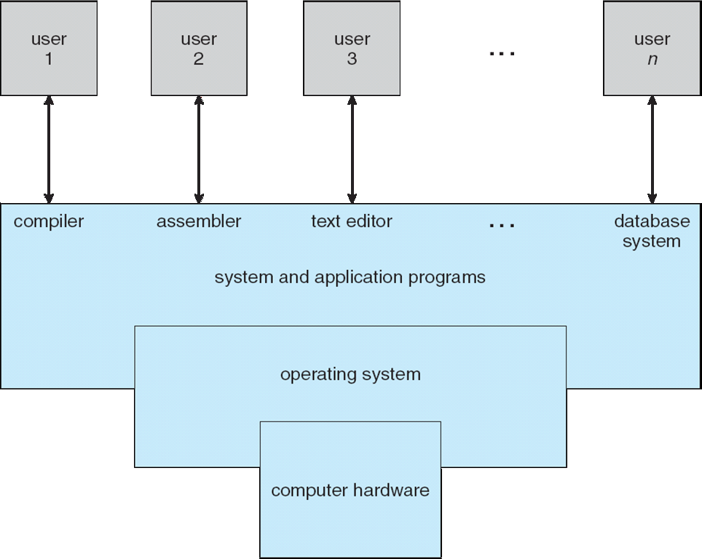
Four Components of a Computer System
Notes:
Timesharing = key in resource management

Slide 6
What Operating Systems Do
Depends on the point of view
Users want convenience, ease of use and good performance
Don’t care about resource utilization
But shared computer such as mainframe or minicomputer must keep all users happy
Users of dedicate systems such as workstations have dedicated resources but frequently use shared resources from servers
Handheld computers are resource poor, optimized for usability and battery life
Some computers have little or no user interface, such as embedded computers in devices and automobiles
Notes:
Users -> low learning curve, easy to use, fast / good performance
Efficient design for computers use i.e. phones don’t have/need high performance cpu/gpu because it will cause battery drainage (not energy efficient)

Slide 7
Operating System Definition
OS is a resource allocator
Manages all resources
Decides between conflicting requests for efficient and fair resource use
OS is a control program
Controls execution of programs to prevent errors and improper use of the computer
Notes:
2 main OS tasks:
- resource management – view to hardware
- view to other applications: control program – managing upper level applications

Slide 8
Operating System Definition (Cont.)
No universally accepted definition
“Everything a vendor ships when you order an operating system” is a good approximation
But varies wildly
“The one program running at all times on the computer” is the kernel.
Everything else is either
a system program (ships with the operating system) , or
an application program.
Notes:
If you want to develop OS, there is no universally accepted def. of what it should include.
No standards.
Kernel – if there is a problem with kernel program, computer crashes. This program is always running, from boot to close
Kernel -> system applications → application program

Slide 9
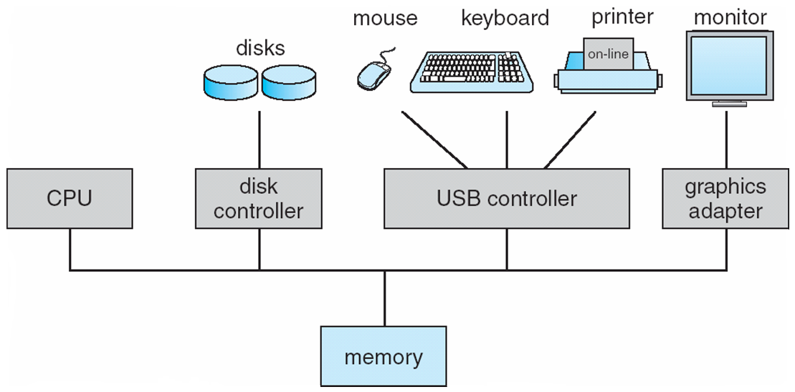
Computer System Organization
Computer-system operation
One or more CPUs, device controllers connect through common bus providing access to shared memory
Concurrent execution of CPUs and devices competing for memory cycles
Notes:
CPU, graphics card, and memory – share BUS (fast traffic controller)
Keyboard, mouse, disks – share another BUS (slow traffic controller)

Slide 10
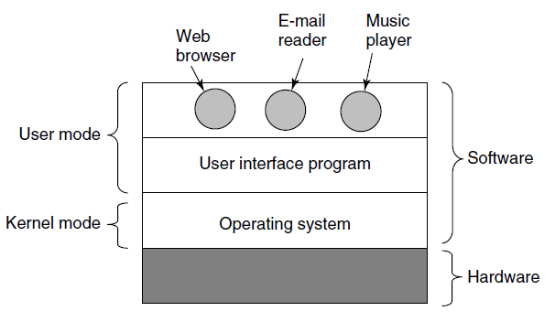
Components of a Modern Computer (2)
Where the operating system fits in.

Slide 11
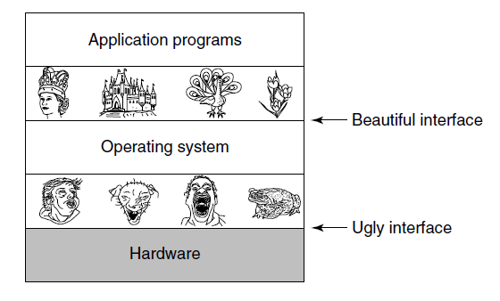
OS is an Extended Machine

Slide 12
OS is a Resource Manager
Top down view
Provide abstractions to application programs
Bottom up view
Manage pieces of complex system
Alternative view
Provide orderly, controlled allocation of resources

Slide 13
History of Operating Systems
The first generation (1945–55) vacuum tubes
The second generation (1955–65) transistors and batch systems
The third generation (1965–1980) ICs and multiprogramming
The fourth generation (1980–present) personal computers
The fifth generation (1990–present) mobile computers

Slide 14
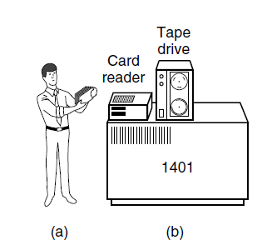
Transistors and Batch Systems (1)
An early batch system.
(a) Programmers bring cards to 1401.
(b) 1401 reads batch of jobs onto tape.

Slide 15
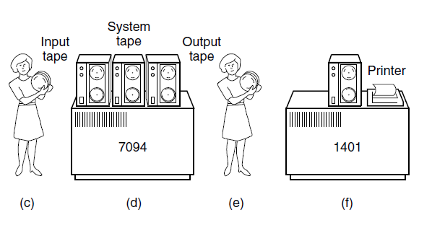
Transistors and Batch Systems (2)
(c) Operator carries input tape to 7094.
(d) 7094 does computing.
(e) Operator carries output tape to 1401.
(f ) 1401 prints output.

Slide 16
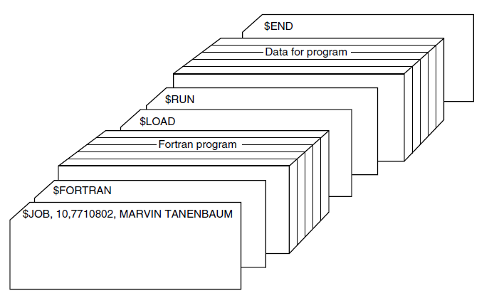
Transistors and Batch Systems (3)
Structure of a typical FMS job.

Slide 17
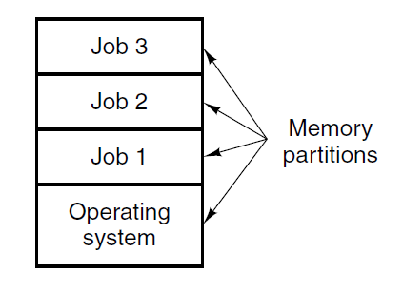
ICs and Multiprogramming
A multiprogramming system with three jobs in memory.

Slide 18
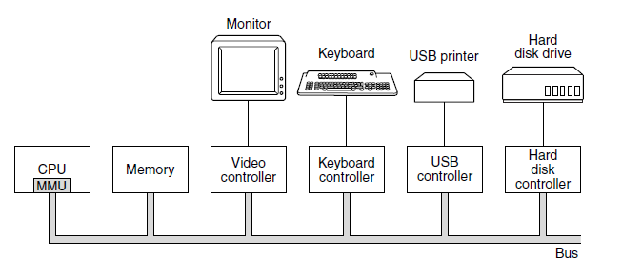
Processors (1)
Some of the components of a simple personal computer.

Slide 19
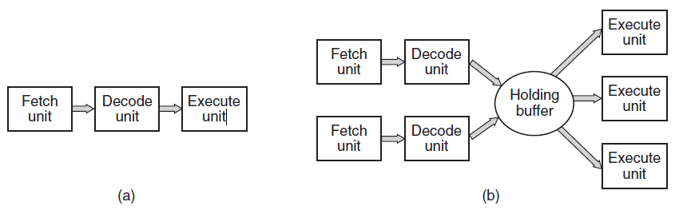
Processors (2)
(a) A three-stage pipeline. (b) A superscalar CPU.

Slide 20
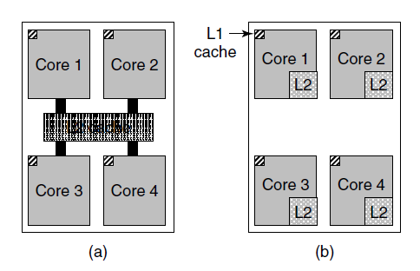
Memory (1)
(a) A quad-core chip with a shared L2 cache. (b) A quad-core chip with separate L2 caches.

Slide 21
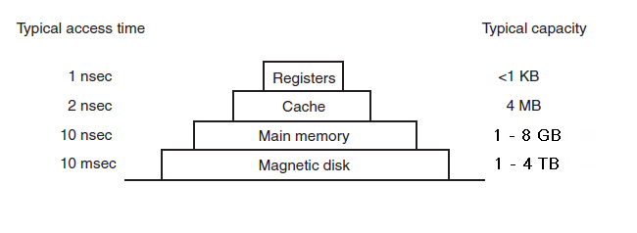
Memory (2)
A typical memory hierarchy.

Slide 22
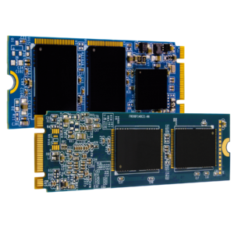
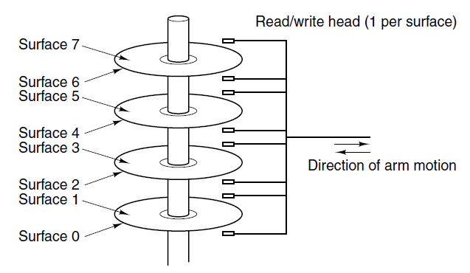
Disks
Structure of a disk drive.
Solid State Drive

Slide 23
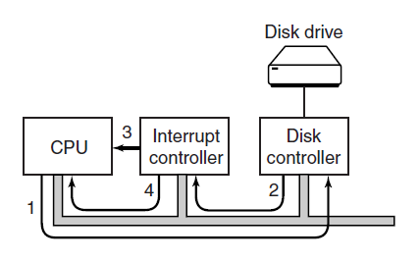
I/O Devices
(a) The steps in starting an I/O device and getting an interrupt.

Slide 24
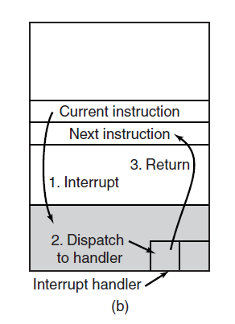
I/O Devices
(b) Interrupt processing involves taking the interrupt, running the interrupt handler, and returning to the user program.

Slide 25
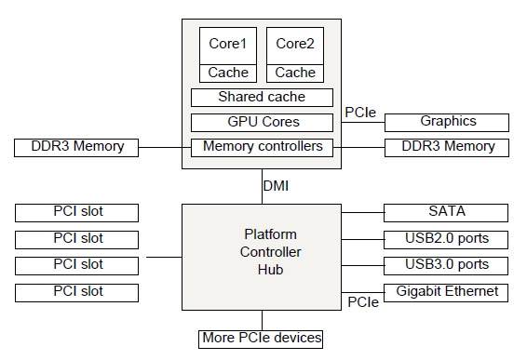
Buses
The structure of a large x86 system

Slide 26
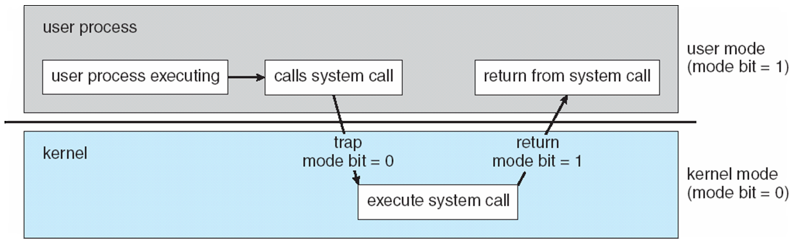
Operating-System Operations
Dual-mode operation allows OS to protect itself and other system components
User mode and kernel mode
Mode bit provided by hardware
Provides ability to distinguish when system is running user code or kernel code
Privileged instructions only executable in kernel mode
System call changes mode to kernel, return from call resets it to user
Notes:
2 layers in OS:
- kernel (from start until power off)
* not directly interacting with input/output devices
* privileges only accessible to kernel
* manages resources, make available, and share to other applications
* cannot have 2 writers for in/out or other systems, kernel manages this

Slide 27
Timer
Timer to prevent infinite loop / process hogging resources
Timer is set to interrupt the computer after some time period
Keep a counter that is decremented by the physical clock.
Operating system set the counter (privileged instruction)
When counter zero generate an interrupt
Set up before scheduling process to regain control or terminate program that exceeds allotted time

Slide 28
Process Management
A process is a program in execution.
Program is a passive entity
Process is an active entity.
Process needs resources to accomplish its task
CPU, memory, I/O, files
Initialization data
Program Counter: next instruction to execute
Single thread process
Multiple threaded process

Slide 29
Process Management Activities
The OS is responsible for:
Creating/Deleting processes
Suspending/Resuming processes
Providing mechanisms for process synchronization
Providing mechanisms for process communication
Providing mechanisms for deadlock handling
Notes:
1st project
Creating processes based on what you need
Terminating a process
Suspend/resume processes
Communication
Dead lock handling
**all essential components for process management

Slide 30
Memory Management
Determines what is in memory and when
Activities
Keeping track of which parts of memory are currently being used and by whom
Deciding which processes and data to move in/out of memory (Swapping)
Allocate/Deallocate memory space
Notes:
How to use storage efficiently, allocate and dealloc space

Slide 31
Storage Management
OS provides uniform, logical view of information storage
File: Abstract of logical storage unit
File-System management
Files usually organized into directories
Access control to determine who can access what
OS activities (logical)
Creating/Deleting files and directories
Primitives to manipulate files and directories
Mapping files onto secondary storage
OS activities (physical)
Free-space management
Storage allocation
Disk scheduling
Notes:
File managers
Delete/create files

Slide 32
Performance of Various Levels of Storage
Movement between levels of storage hierarchy can be explicit or implicit

Slide 33
I/O Subsystem
Hide peculiarities of hardware devices from users
I/O subsystem responsible for
Memory management of I/O including
buffering
caching
spooling
General device-driver interface
Drivers for specific hardware devices

Slide 34
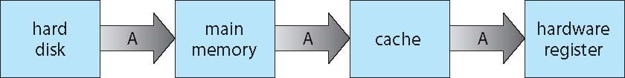
Migration of data “A” from Disk to Register
Multitasking environments must be careful to use most recent value, no matter where it is stored in the storage hierarchy
Multiprocessor environment must provide cache coherency in hardware such that all CPUs have the most recent value in their cache
Distributed environment situation even more complex
Several copies of a datum can exist
Various solutions covered in Chapter 17
Notes:
How to read from hard -> main memory

Slide 35
Protection and Security
Protection – any mechanism for controlling access of processes or users to resources defined by the OS
Security – defense of the system against internal and external attacks
Huge range, including denial-of-service, worms, viruses, identity theft, theft of service
Systems generally first distinguish among users, to determine who can do what
User identities (user IDs, security IDs) include name and associated number, one per user
User ID then associated with all files, processes of that user to determine access control
Group identifier (group ID) allows set of users to be defined and controls managed, then also associated with each process, file
Privilege escalation allows user to change to effective ID with more rights

Slide 36
The Operating System Zoo
Mainframe Operating Systems
Server Operating Systems
Multiprocessor Operating Systems
Personal Computer Operating Systems
Handheld Computer Operating Systems
Embedded Operating Systems
Sensor Node Operating Systems
Real-Time Operating Systems
Smart Card Operating Systems

Slide 37
End of Chapter 1

